Slide 1
DSEM 6105 Project E-Commerce Shipping
Team Members:
Saneel Tare
Saloni Sankhe
Mitali Gupta
Harsh Oswal

Slide 2
Content
Introduction
Workflow
Data
EDA
Models
ROC Curve
Business Recommendations

Slide 3
Introduction
E-commerce shipping encompasses receiving and processing orders, picking and packing the purchased product at a warehouse, printing shipping labels, and even managing returns. All the moving pieces create a level of complexity that depends on the types and sizes of products you sell, to which regions you’ll deliver, the delivery options and shipping speeds you choose to offer and more.
Shipping on time has major significance for E-Commerce companies. It helps in increasing the reputation of the company, broadens the relationship with the clients and hence enhances the customers’ confidence and their buying ability and raise the overall profit for the company.
The goal of our project is to determine whether the products are shipped on time or not.

Slide 4
Workflow
Search for Dataset
EDA
Classification Model
Models
AUC Curve

Slide 5
Data
Source
Kaggle.com
Size
10999 rows 12 columns
Type
int64 object

Slide 6
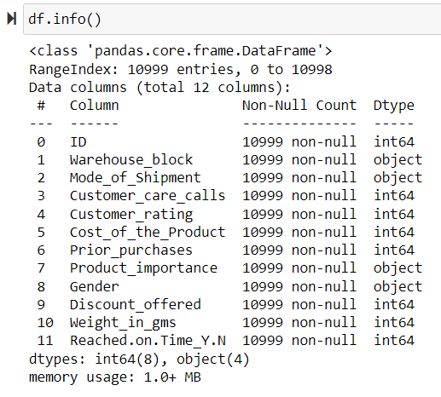
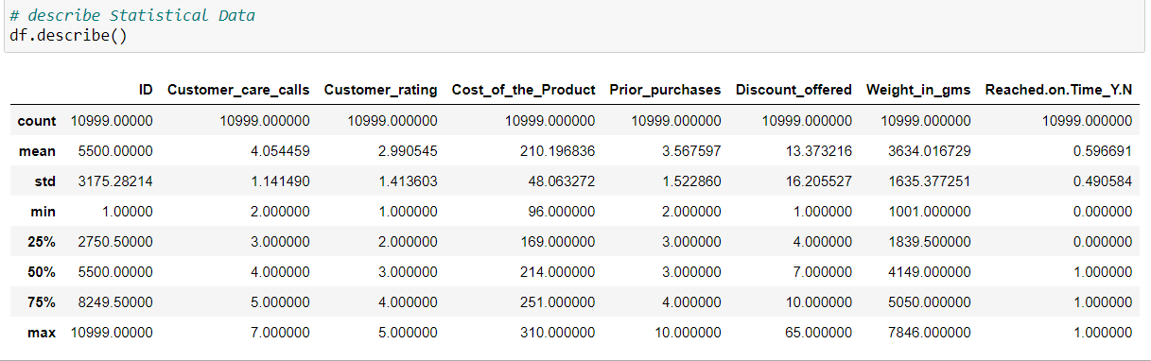
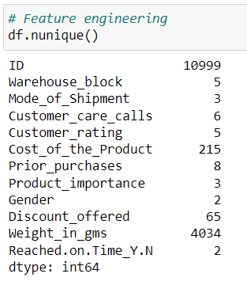
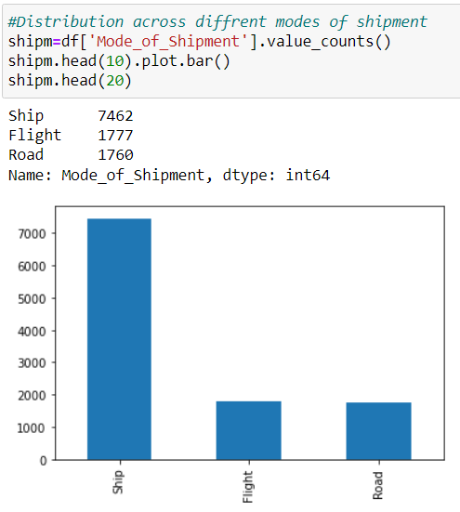
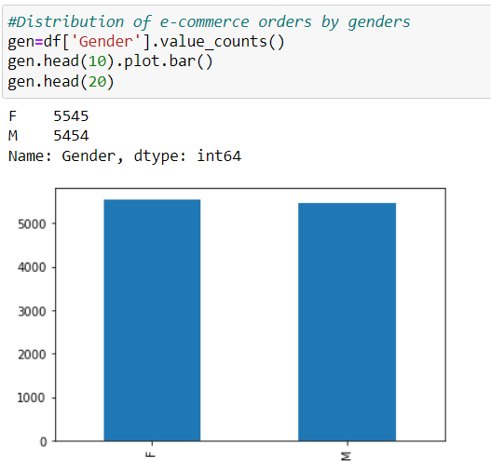
EDA

Slide 7
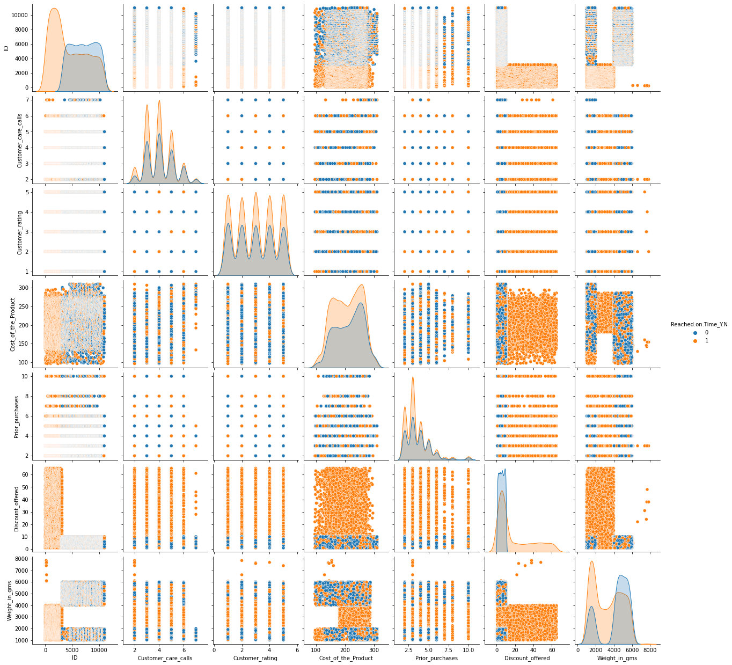
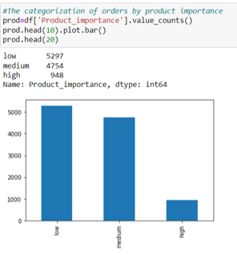
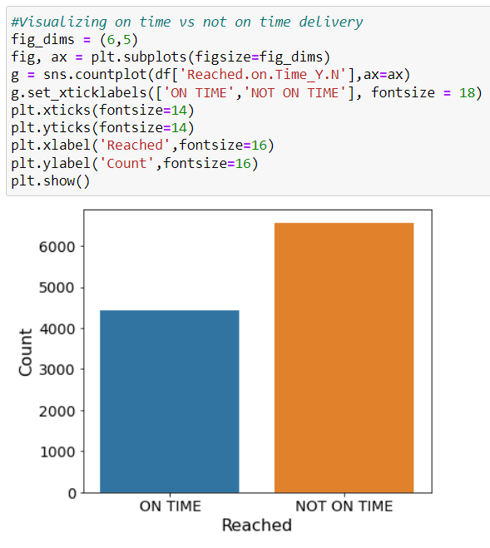
EDA

Slide 8
Data Processing
• Separating numerical and categorical values • Handling Numerical Values - Scaling and Standardization
• Handling Categorical Values - Integer and One Hot Encoding • Select best features for modeling • Normalize & Standardize all selected features
• Saving the dataset for further usage

Slide 9
Modelling
• Split features & target
• Split data into train, valid & test data
• Train model with 5 different algorithm - Decision Tree, Logistic Regression, Random Forest, XGBoost and KNN
• Evaluate model with Accuracy, Precision, Recall, F1-Score and AUC Score
• Hyper parameter tuning
• Feature Selection
• Select the best model

Slide 10
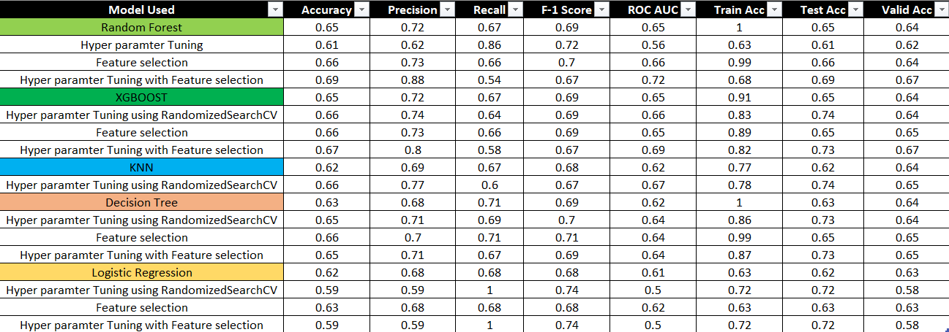
Comparison of model performances

Slide 11
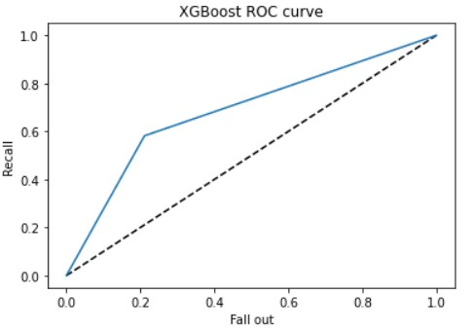
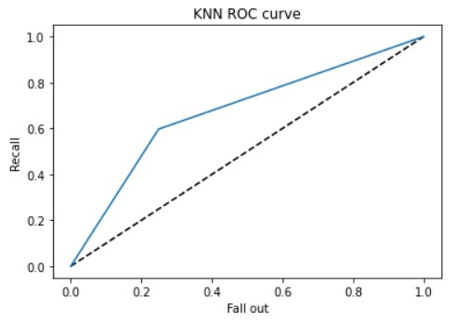
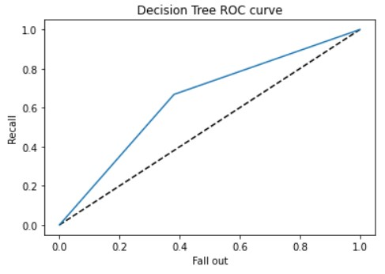
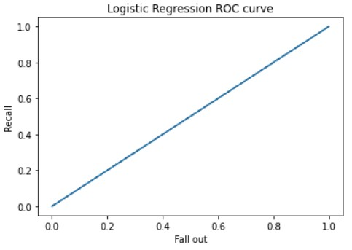
AUC-ROC Curves

Slide 12
Business Recommendations
Short terms
• Add estimated arrival time to assure the package arrived on time • Give credit points as a compensations to retain customer loyalty
Long terms
• Add more features to give more specific & accurate insights • Perform operational audit based on the insights

Slide 13
Thank you

